Slide 1
Computer Systems, Data Structures & Data Management
Markos Vassilis
Mediterranean College
Week 13

Slide 2
Databases

Slide 3
Course Outline (Roughly): Weeks 13-18
Database (DB) design principles.
Models, Views, Schemata, …
The almighty E-R Model
Database Languages
Other cool stuff about Databases…
Apply all the above with MS Access 2016 (?).

Slide 4

Our Holy Bible
Database System Concepts, Abraham, Silberschatz, Henry, F., Korth, S. Sudarshan, Sixth Edition, McGraw Hill, ISBN 978-0-07-352332-3.
You can access it through the college’s library / Derby library.
If you have any issues finding it, contact me to find a way.

Slide 5
Assessment
MS Access Course:
  An introductory LinkedIn course about MS Access, worth 5% of your final grade.
Term Project:
  A database design project implemented on MS Access.
  You also have to provide documentation!
  Worth 50% of your final grade.
Quizzes about cool stuff:
  Worth 25% of your final grade, as in Fall semester.
Final Exam:
  A final exam on everything covered throughout both semesters, worth for another 25% of your final grade.

Slide 6
What are “Data”?
Plural of “datum”?
Stuff that helps us draw conclusions?
Potentially everything around us?
All of the above.
But, then, what is a DB?
A database is an organized collection of data (also known as a data store) stored and accessed electronically through the use of a database management system (DBMS).

Slide 7
Building Databases…
Assume you are running the XYZ University Computing Department. You have plenty of data at your disposal, such as:
students’ personal information (name a few);
teaching staff’s personal information (name a few);
course information (name some);
relations between the above (name some).
Could you organise the above into a coherent and organised collection of data?
Take pen and paper and write down your thoughts (make diagrams, notes, whatever makes sense to you).

Slide 8
Why use Databases? 1 / n
Millions of reasons, but, at a high level, all can be summarised as follows:
Data per se are unstructured, unorganised and difficult to process. DBs impose structure which, if exploited appropriately, can speed up processes such as searching for certain entities or relating entities to one another, etc.

Slide 9
Why use Databases? 2 / n
Assume you run a pet clinic, maintaining, among others, records about 1000 dogs and 1000 cats. Further assume that you would like to retrieve the medical record of a dog, Alice, to prepare for an upcoming surgery:
Assuming that you keep all data at one place with no further structure, how many lookups you should do in the worst case to find Alice’s records? On average?
Assuming that you keep dog- and cat-related data separated, how many lookups you should do in the worst case to find Alice’s records? On average?
Can you thing of other ways to speed up lookup in this simple scenario?

Slide 10
Those Millions of Reasons… 1 / n
Once upon a time, at the XYZ University, all records were kept in separate system files. To access those files and the precious data they contained, various computer programs had been developed to add and remove students / faculty members and courses, enrol students to courses and assign faculty members to them, grade students, compute their GPAs and many more…
The need for a new Master’s arises. What have the programmers at XYZ University to do to accommodate its data-storing needs?
Write new / Amend existing system files and compose programs to access them.
Are there any issues with this approach?

Slide 11
Those Millions of Reasons… 2 / n
Data inconsistency: Different files are quite possible to have different structure, resulting to different programs manipulating them, while still describing the same thing (e.g., students of different programmes of study).
Data redundancy: A professor teaching Databases and Object-Oriented Programing might be included in both courses’ files - while still being the same person teaching both.
Difficulty in accessing data: Assume it is really important to find all students currently at their second year of studies, regardless of any other parameter. In the worst case, you have to either look into each system file separately to find your students or have a program implemented to do that for you.

Slide 12
Those Millions of Reasons… 3 / n
Data isolation: The university exists for a long time, thus programs to access data and data files are generated across a large time span. What are the chances that they all adhere to the same format? Minuscule, if any. Thus, developing programs that somehow process such files has to deal with those inconsistencies.
Integrity problems: Students at XYZ are required to successfully attend courses worth at least 20 ECTS per year. This restriction is manually imposed to all data by corresponding programs. At some time, XYZ’s senate decides that this should be changed to at least 15 ECTS per year and 40 ECTS throughout the last two years. To introduce this new constraint, developers must each time edit all relevant programs.

Slide 13
Those Millions of Reasons… 4 / n
Atomicity Problems: Assume you have a student which decides (in time) to switch from Databases course to Networks and Security. Given that such info is held at different places, the student has to be deleted from Databases roster and added to the Networks and Security one. However, a system failure might interrupt this process removing thus the student from Databases and not adding them to Networks and Security. We say that in that case the process is not atomic (i.e., it does not happen as “an atom”, as one).
Concurrent access anomalies: What if two students are added at the same time in a course? Assume the Databases course has currently 10 students and Alice and Bob enrol at the same time. The corresponding programs read both the initial value (10) and update the course student count each to 11 (because each has added one student). Such cases require higher-level supervision.

Slide 14
Those Millions of Reasons… 5 / n
Security problems: How can you make sure that certain users don’t have access to certain files? A step forward, how do you ensure that they don’t have access to certain information across different files? How can you do that efficiently? How can you do that consistently?
An efficient way to address all of the above is, guess what, to introduce structure and organise data appropriately, i.e., make use of a DB.

Slide 15
Interacting with a DB 1 / n
DBs = Data + Programs about those data (access, modification etc).
Imagine the following people, all working at the XYZ university:
  A clerk at the university’s secretariat.
  A data analyst making some data analysis regarding XYZ’s students.
  A back-end developer, working on the improvement of XYZ’s infrastructure.
Do all three need the same “type” of access to the university’s DB?
Clearly, no.

Slide 16
Interacting with a DB 2 / n
Three levels of abstraction:
Physical level: Really low-level representation, regarding sophisticated data structures used to store data efficiently (the back-end’s view).
Logical level: Higher level description, including what data are stored using a few simple data structures but no lower-level information. Any lower-level complexity is hidden from the user (physical data independence) (the data-analyst’s view).
View level: The highest level of abstraction. The user views only parts of the DB that are relevant to their purposes (the clerk’s view).
view1
view2
view3

Slide 17
Interacting with a DB 3 / n
What is expected to change in a DB?
Data, i.e., the entries in the DB.
All information (data) included in a DB at a certain moment is called an instance of the DB.
What is not expected to change in a DB?
How data are organised.
The way data are organised in a DB, i.e., its design, is called the DB’s schema.
ATTENTION! Schemas (or schemata) may change over time, if needed, however this is not what they primarily are for (can you think of such reasons?)

Slide 18
Interacting with a DB 4 / n
Can the same schema work for our beck-end developer, data-analyst and clerk?
No! Essentially, schemas implement the DB levels of abstraction:
Physical schemas describe DB design at the physical level (the technician’s view).
Logical schemas describe DB design at the logical level (the data-analyst’s view).
Subschemas describe DB design at the view level (the clerk’s view).
view1
view2
view3

Slide 19
Data Models 1 / n
A data model is a collection of conceptual tools for describing data, data relationships, data semantics, and consistency constraints. A data model provides a way to describe the design of a database at the physical, logical, and view level.
Essentially, data models provide the structure “under the hood” of a DB at:
The physical level, i.e., the primitive data structures used to physically store data.
The logical level, i.e., the higher level constructs used to organise stored data.
The view level, i.e., the constructs used for partial sharing of DB data.

Slide 20
Data Models 2 / n
There are four broad categories of data models:
Relational Model: Data are organised in tables (relations) representing both data and their relationships. Each table corresponds to records of a certain type, whose attributes are the columns of the table.
Attributes
ID | Name | Surname | Programme of Study
6132489 | John | Doe | Computer Science
2380935 | Jane | Dan | Accounting
4357923 | Alice | Null | Law
Table
Record

Slide 21
Data Models 2 / n
Entity-Relationship Model: Data are organized on the basis of entities, which correspond to things or objects of the real world (e.g., a course at the XYZ university or a faculty member), and relationships among those entities.
id
id
name
1
n
name
Student
Attends
Course
surname
room
prog.
type

Slide 22
Data Models 3 / n
Object-Based Data Model: Mimicking Object-Oriented Programing (OOP), this paradigm extends the E-R model by allowing for encapsulation, methods, inheritance and other OOP ideas. There is also the object-relational model which combines the Object-Based and Relational models.
Semi-structured Data Model: Similar to the above, but allowing for data types of the same type (e.g., “student” or “course”) but not always with the same attributes. The most widely used language for such cases is XML (eXtensible Markup Language).

Slide 23
DB Languages 1 / n
DBs = Data + Programs about those data (access, modification etc).
Equivalently: DBs = Data + Processes
Two families of DB Languages:
  Data-definition languages (DDL): Used to describe the DB schema.
  Data-manipulation languages (DML): Used to express DB queries and updates.
A DB Language can be both DDL and DML. Actually, most modern languages offer both schema description and query functionalities.

Slide 24
DB Languages 2 / n
DDL: Languages concerned with how data are kept in a DB:
Consistency Constraints: Constraints that stored data should satisfy at any time. E.g., students at the XYZ university should at any time be registered to course of the programmes of study they are enrolled to (which problem does this solve?).
Types of Consistency Constraints:
  Domain Constraints, i..e., the range of values for every attribute.
  Referential Integrity, i.e., keep track of attributes that should appear in more than one places.
  Assertions, i.e., conditions that a DB should always satisfy.
  Authorization, i.e., differentiation among users and their level of access (e.g., read, insert, update, and delete authorization).

Slide 25
DB Languages 3 / n
DML: Concerned with retrieval, insertion, deletion and modification of data in a DB.
Two types of DML:
  Procedural DML: The user specifies what data to get and how to get them.
  Declarative DML: The user specifies what data to get and not how to get them (the latter is decided by the system).
Queries refer to statements regarding the retrieval of information.
While the term query refers only to retrieval of data, we often use the term query language to characterise all DML.

Slide 26
What we saw today… 1 / n
What is the main reason for using a DB?
Data are inherently unstructured, so DBs are used to impose structure and organization on them, to facilitate further processing (searching, splitting, sorting etc).
What are some problems that arose with the use of system files for storing data back in the 60s?
Some of the most significant problems include: data inconsistency, redundancy, difficulty of access, data isolation, integrity and atomicity problems, concurrent access anomalies and security issues.

Slide 27
What we saw today… 2 / n
Briefly describe the three levels of DB abstraction:
The three levels of DB abstraction are:
  Physical level: Data as stored at the lowest level (e.g., the primitive data structures used for that purpose).
  Logical level: Data as organised through higher-level constructs (e.g., teacher, course, student of the XYZ University).
  View level: Data or portions of them as distributed to non-expert end users.

Slide 28
What we saw today… 3 / n
What is a DB instance and what a DB schema? What is their main difference?
DB schemas refer to the design of a database which remains, in general, intact throughout the course of time. On the contrary, DB instances refer to “snapshots” of a DB at a specific moment in time and, in general, are subject to change as data are altered, added or removed from a DB.
What levels of abstraction apply to DB schemas?
The same that apply to DBs, i.e., there are physical schemas, referring to the lowest level organisation of a DB, logical schemas, referring to higher level organisation, and subschemas, referring to how the various DB views are organised.

Slide 29
What we saw today… 4 / n
What is a data model?
A data model is a collection of conceptual tools for describing data, data relationships, data semantics, and consistency constraints.
What are the four main data model categories?
The main data model categories include:
Relational models, which represent data through tables of similar records;
E-R models, which represent data through entities interrelated through relationships;
Object-based models, which borrow concepts from OOP, and;
Semi-structured models, allowing for more relaxed data representation.

Slide 30
What we saw today… 5 / n
Right or Wrong? A DB language can be both a data-description and a data-manipulation language.
Right. Most modern languages include functionalities that support both data manipulation as well as their description.
What types of Consistency Constraints are implemented by DDL?
Four types of constraints, including:
Domain constraints;
Referential integrity;
Assertions, and;
Authorization.

Slide 31
What we saw today… 6 / n
What are the two main categories of DML?
The two main categories of DML are:
Procedural languages, which require the user to specify what data they want to access and how to do so, and;
Declarative (nonprocedural) languages, which require users to specify only what data they want to access, without specifying how.

Slide 32
Time for Fun!

Slide 33
Exploring a DB Language 1 / n
Open a browser window and open the following pages into two separate tabs:
  https://dbdiagram.io/home
  https://dbml.dbdiagram.io/docs/
DB Markup Language (DBML) is a high level DB language which we shall use as an introduction to DB design and DB languages.
It also offers automated generation of E-R diagrams, which is quite useful (so, you could use it for that purpose as well).
It will also give us a chance to get accustomed with exploring the wild west of a language’s documentation (check the second link above).
We will not use DBML as our primary DB language, however, we will often make use of its high level features and syntax.

Slide 34
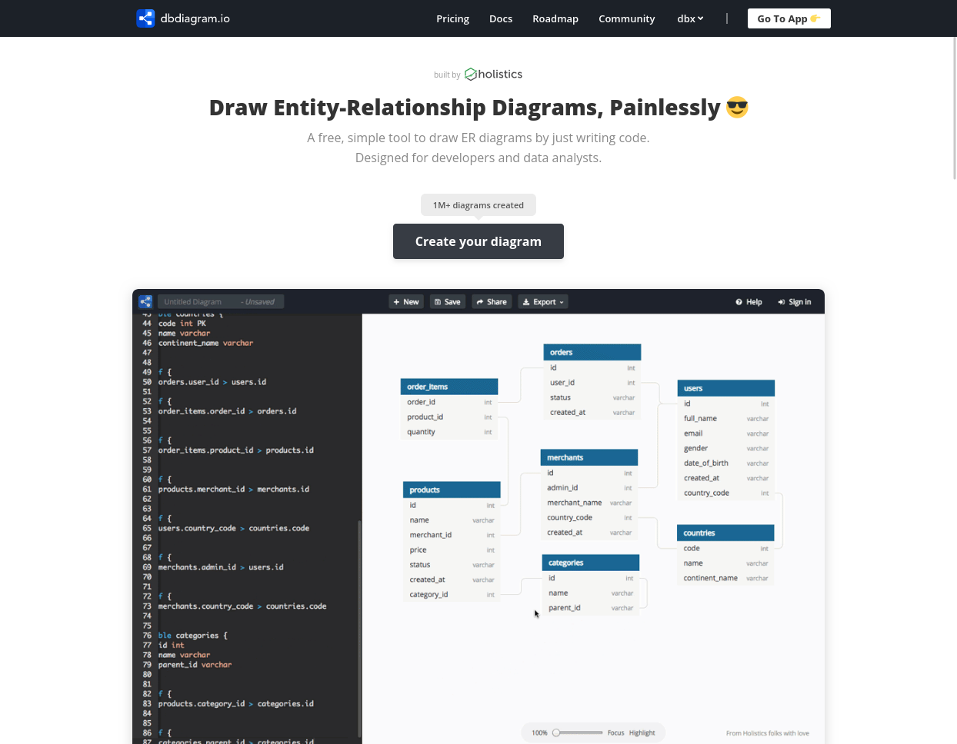
Exploring a DB Language 2 / n
Click on the “Create you diagram” button in: https://dbdiagram.io/home
Click here

Slide 35
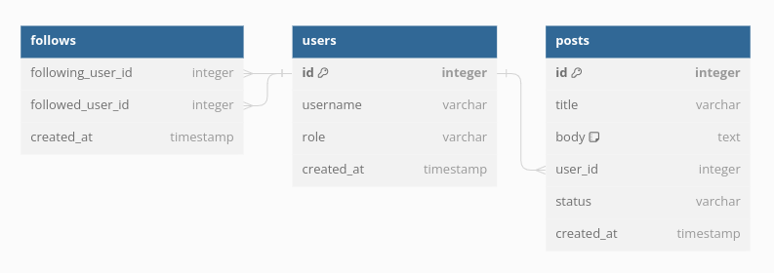
Exploring a DB Language 3 / n
Observe at first the diagram shown on the right of the page. What does it depict?

Slide 36
Exploring a DB Language 4 / n
Relationships
Entities

Slide 37
Exploring a DB Language 5 / n
Primary key
Primary key: an attribute that uniquely identifies a certain entity (e.g., user id).

Slide 38
Exploring a DB Language 6 / n
Many-to-one relationship
One-to-many relationship

Slide 39
Exploring a DB Language 7 / n
Split to groups of 2 or 3.
Discuss how the visual elements we saw above are expressed into DBML. You can always consult the language’s documentation: https://dbml.dbdiagram.io/docs/
Open in a new tab the DBML diagram editor found at: https://dbdiagram.io/d
You aim is to design a small DB schema for the XYZ University Computer Science Department including the following entities:
  students;
  faculty;
  courses.
Which attributes should each of the above entities include? Discuss with your team.
Write the appropriate commands on the code editor (left) to generate the corresponding tables.
What relationships should be included? Write the corresponding DBML code to demonstrate them.

Slide 40
Homework!
Expand your work done in classroom regarding the XYZ University Computer Science Department. You might, among others, consider the following:
Which other entities should be included?
What are their attributes?
Which other relationships are required?
Collect the corresponding DBML code, the generated E-R graph and a brief description of your way of thinking in a single document, which you should send me at: v.markos@mc-class.gr.

Slide 41

Any Questions?
Don’t forget to fill-in the questionnaire! (check right)
https://forms.gle/edpsrRjMWJwPtv3U9

